Slide 1
נ.נ. בתכנון משולב חומרה/תוכנה אביב – 00460882 תרגול 3
אוהד איתן

Slide 2
נ.נ. בתכנון משולב חומרה/תוכנה אביב – 00460882 תרגול 3 – When hardware and software engineers refuse to collaborate…
אוהד איתן

Slide 3

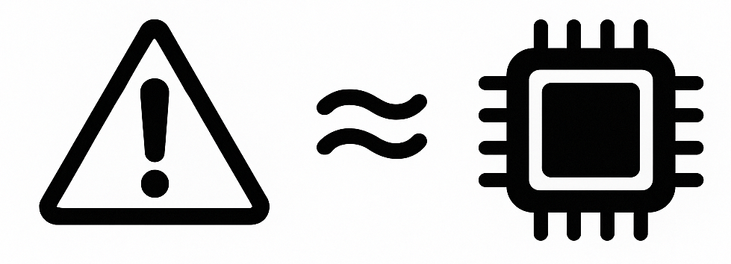
Precise exceptions in relaxed architectures

Slide 4
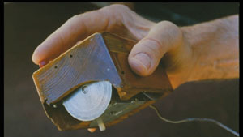
1964
1963

Slide 5

1964
1962

Slide 6
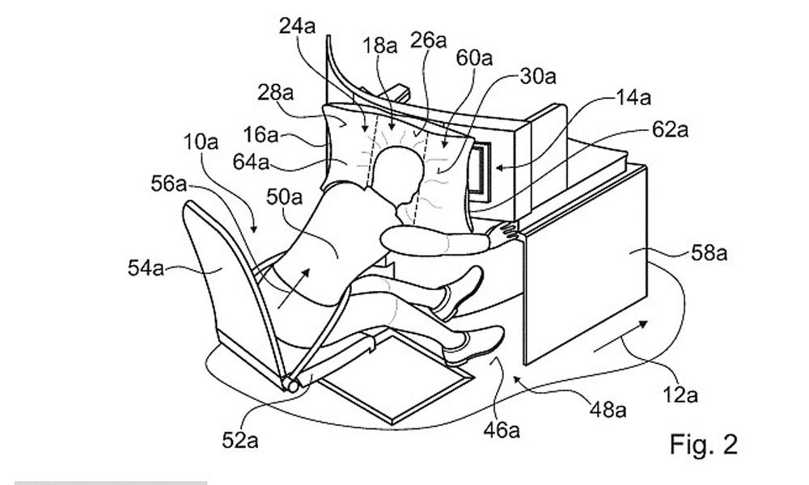
1964
1968
1962

Slide 7

1964
1968
1962
1963

Slide 8
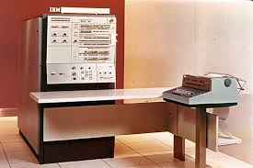
Defining Precise Exceptions
“An exception is imprecise if the processor state when an exception is raised does not look exactly as if the instructions were executed sequentially in strict program order”
-IBM System/360-
This definition shaped computer architecture for decades… but is it enough for today’s out-of-order, speculative processors?

Slide 9
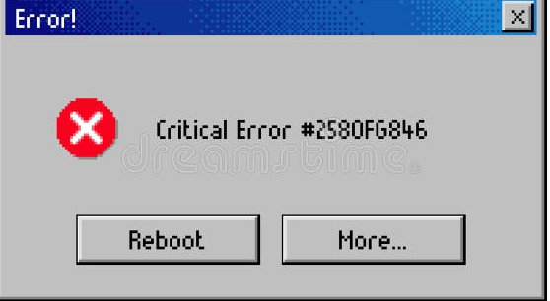

Exceptions special events, break normal flow, an error or unexpected situation
Relaxed behavior weaker rules, looser guarantees, no memory consistency, synchronization
Notes:
It allows more flexibility and efficiency, but may introduce nondeterminism or weaker guarantees compared to strict behaviour.

Slide 10
Memory Consistency: Sequential vs. Weak.
A memory consistency model defines the order in which memory operations (reads and writes) from different processors appear to execute.
Sequential Consistency
Weak Consistency
Strict ordering guarantee
All processors see the same order
Slower performance
Relaxed ordering rules
Processors may see different orders
Requires explicit synchronization
Better performance

Slide 11
Sequential Consistency - Example
P1:
X = 1 // Write
print(Y) // Read
P2:
Y = 1 // Write
print(X) // Read
Under Sequential Consistency:
Both processors printing 0 is impossible.
At least one write (X=1 or Y=1) must be visible to the other's read, so at least one processor must print 1.

Slide 12
Weak Consistency - Same Example
P1:
X = 1 // Write
print(Y) // Read
P2:
Y = 1 // Write
print(X) // Read
Both can print 0!
The hardware may reorder the write and read on each processor.
Each processor's read can execute before the other's write becomes visible.

Slide 13
The Challenge
Exceptions should be precise → appear to occur between instructions.
Modern CPUs allow relaxed/out-of-order execution → hard to define precision.
Sequential execution model
Out-of-order + relaxed memory

Slide 14
Hardware Exceptions
⚡Interrupts → External events (devices)
🧩Traps → Intentional (system call)
🧱Faults → Correctable errors (page fault)
❌Aborts → Unrecoverable errors (memory corruption)

Slide 15

🔒Privilege transitions user ↔ kernel mode switch
🟢Recoverable faults detect and correct
🔴Non-recoverable faults

Slide 16
The Challenge in Modern CPUs
Programmers need clear semantics
Exceptions + relaxed memory →been explored.
Achieving precision on modern CPUs is nearly impossible.
Notes:
Haven't been studied before.

Slide 17
Interrupts
Signals that come from outside the current program, telling the processor that something needs attention. 🖱️ Peripherals (keyboard, NIC)
⏰ Timers
🖥️ Other processors (multiprocessor systems)
⚠️ System errors (report faults that require handling)

Slide 18
Precision
⚙️Precise Exception occurs when the CPU can exactly identify which instruction caused the fault and where to resume after handling it. Observed at specific instruction points.
🔁 Can resume using saved address (after handling the exception).
🧩All interrupts are precise, except external aborts
🧯Recovery depends on the type of fault
Notes:
לדוגמה, שגיאה בלתי ניתנת לתיקון ובלתי מדויקת. עשויה להיווצר עקב גילוי מאוחר של שגיאת תיקון שגיאות זיכרון בלתי ניתנת לתיקון.

Slide 19

Exception Entry Flow (ARM)
When an exception is taken, execution jumps to the exception vector, an offset from the appropriate vector base address register (VBAR) value depending on the kind of exception.
Registers such as ESR, FAR, ELR, and EL are updated with exception-related values.

Slide 20
What Held True 60 Years Ago Does Not Necessarily Apply Today
We were taught that: processors execute instructions sequentially.
According to Arm’s manual, it has around 60 instances of instruction stream or execution stream.
⚙️ From instructions to fetch-decode-execute instances (FDX).
⚡ Exceptions can arise at multiple points within the FDX, even within the fetch-decode, when there is no ‘instruction’
Time
4 BC –
Birth of Jesus Christ
1960s Sequential
Today’s relaxed CPUs

Slide 21
Program-Order-Before/After
🧭program order the Instructions a logical order given by the program listing (assembly).
The store is program-order-before the load
The load is program-order-after the store.
Reads may be satisfied speculatively. Writes cannot be propagated speculatively.
STR X0, [X1] // store
LDR X2, [X3] // load

Slide 22
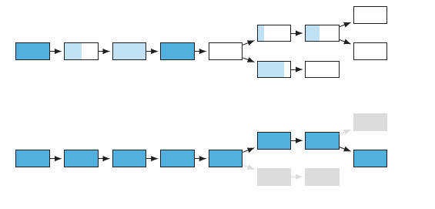
Tree of Partially and Completely Executed Instances
The tree of (partially) executed FDX instances
Committed instances can be program-order after in-flight instances.
Non-committed instances may need to be restarted.
dark blue - committed FDXs
light blue – in flight (partially/tentatively executed) FDXs.
completed execution

Slide 23

Instruction
Exception
Handler
Resume

Slide 24
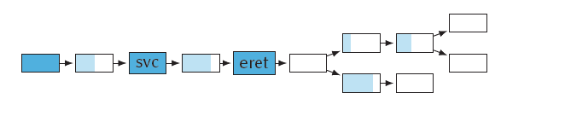
Exception Handling and Precision
Exception entry (svc)
Exception return (eret).
The hardware may handle an exception, even before program-order-before instructions have fully completed.
Instructions may execute OOO across exception boundaries, requiring a modern definition for precision.

Slide 25

Exceptions and Context Synchronization
Exceptions change the control flow and processor context.
Context includes:
- Current exception level
- Interrupt masking
- Processor flags & special registers
Changes may not take effect immediately.
Program-order-later instructions must observe updated context.

Slide 26
Exceptions: Sources and Their Impact
An interrupt is the most common type of exception.
A page fault is the most common fault-type exception.
Exception may come with extra synchronization (memory barriers) and/or non-determinism (timing of interrupts).
System calls are useful for exploring these effects.
-act as exception-generating instructions.
-a baseline for studying precision in relaxed memory models.

Slide 27
Ordering Remains Relaxed Across Exception Boundaries
Even though an exception is taken, the architecture allows reads/writes to forward values across the boundary.
Forwarding and reordering can still happen unless explicit barriers are inserted.
The exception handler itself runs non-speculatively (it doesn’t execute before the exception is confirmed),
Notes:
It doesn’t. Forwarding and reordering can still happen unless explicit barriers are inserted.

Slide 28
Exception Metadata Can Enforce Ordering
When an exception is taken or returned from, system registers are read as part of context.
These reads can participate in register dependency chains, even if the exception logic itself is unaffected.
Such dependencies compose with context synchronization and may enforce ordering to program-order-after instructions.

Slide 29
Not All Exception Kinds Are Equal
Page faults gain additional ordering from program-order-before.
Interrupts and other asynchronous events do not guarantee such ordering.
⚠️ Interaction between page faults and asynchronous interrupts is subtle and may require domain-specific clarification.

Slide 30
Challenges in Defining Precision
Arm reference defines precision as:
An exception is precise if, on taking the exception, the hardware thread state and the memory system state are consistent, with the processing element having executed all of the instructions up to, but not including, the point in the instruction stream where the exception was taken from, and none afterwards.

Slide 31
Exceptions and Side Effects Under Relaxed Memory
This definition allows some side effects of faulting instructions to be visible:
Unused registers values: UNKNOWN
Writes not causing exceptions may also become UNKNOWN
Both can be observable by handler or other threads.
This means instruction streams don’t capture relaxed-memory effects. While Arm classifies exceptions as precise or imprecise, defining precision under relaxed memory is inherently difficult.

Slide 32
Generic Interrupt Controller (GIC)
A complex hardware component, with a 950-page specification.
Modeling it fully would be a major project.
GIC
CPU Cores
Devices

Slide 33
IPI, SGI, and GIC: Coordinating Cores
🧠IPI – inter processor interrupt. An interrupt one CPU core sends to another in a multiprocessor system.
💻SGI – Software generated interrupt. A software-triggered interrupt used to signal another core- the Arm equivalent of an IPI.
⚙️GIC – Generic Interrupt Controller, Arm’s hardware block for managing interrupts across cores, providing a uniform API for sending and routing them.
Use of SGIs depends on understanding how exceptions interact with relaxed-memory behavior.

Slide 34
Interrupt Ordering and Delivery Guarantees
⚠️ There are few guarantees on the order of SGI or interrupt delivery.
🧩Interrupts can reach a core at any time, and multiple pending ones may arrive in any order.
🔀 Unlike memory operations, interrupts lack coherence or atomicity guarantees, they may be reordered or delivered differently across cores.
🚫However, interrupts can’t be speculated, so they’re never delivered before being generated.

Slide 35
Interrupt Flow in the GIC
✳️An interrupt originates from a hardware thread or peripheral and is sent to the interrupt controller, which includes a distributor (routes interrupts to cores) and redistributors (manage per-core state).
🆔Each interrupt has an INTID assigned by software or hardware, identifying it to the receiving core via a register.
Core
GIC Distributor
CPU
Redistributor

Slide 36
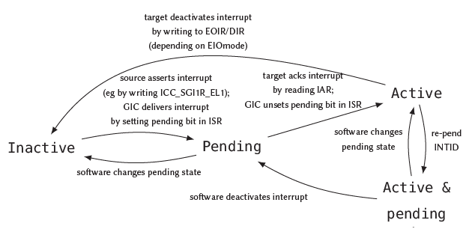

Slide 37
How does Software Handle Interrupts?
Nested servicing: handle immediately using priorities (common in real-time OSs).
Deferred handling: acknowledge now, process later.
When taken, the core acknowledges the interrupt, checks the INTID, lowers priority, and unmasks interrupts.

Slide 38
Summary of Our Discussion
We address the open problem of defining precision in relaxed architectures.
We outline simple guarantees of precision that help apply the same reasoning methods used for nested interrupts.
We extend the Arm-A memory model to include exceptions, aiming to.

Slide 39
Summary of Our Discussion
We start modeling software-generated interrupts and the key parts of the interrupt system used by most platforms.
While more work remains on exceptions and interrupts, this forms a solid foundation for future development.

